Slide 1
Uveitis
Dr. Fareed Warid
Consultant Ophthalmologist

Slide 2
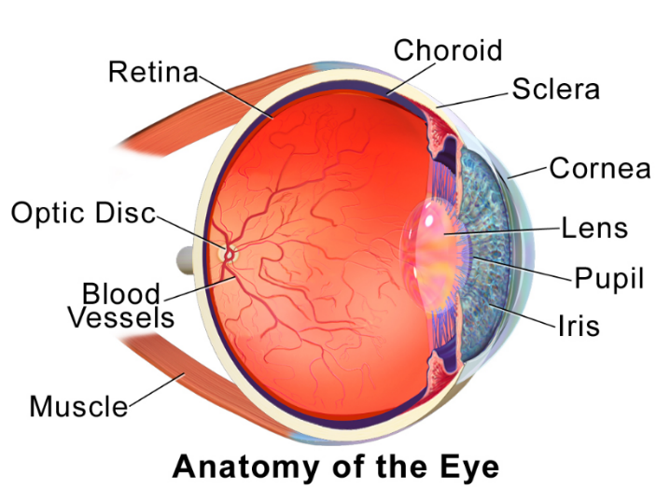
Definition: an inflammation of the uveal tract.
Anatomical classification:
iris,
ciliary body
choroid.
Anterior Uveitis :
• Iritis: in which the inflammation primarily involves the iris.
• Iridocyclitis :in which both the Iris and Pars Plicata of the Ciliary Body are involved.
Intermediate Uveitis:
is defined as inflammation predominantly involving the Pars Plana, Peripheral Retina and Vitreous.
Posterior Uveitis:
involves the fundus posterior to the vitreous base.
• Retinitis with the primary focus in the Retina.
• Retinal Vasculitis which may involve Retinal Veins, Arteries or Both.
• Choroiditis with the primary focus in the Choroid.

Slide 3
Panuveitis:
implies involvement of the Entire Uveal Tract without a predominant site of inflammation.
Endophthalmitis:
implies (Infection)inflammation, often purulent, involving All Intraocular Tissues except the sclera.
Panophthalmitis :
involves the Entire Globe , often with orbital extension.

Slide 4
Acute anterior uveitis (AAU)
Most common form of uveitis
Three quarter of cases ( ¾)
Sudden onset
Duration of 3 months or less.

Slide 5
Presentation
Symptoms:
sudden onset of (usually) unilateral
Pain
Photophobia
Redness
with or without hyper-lacrimation.
Signs
Visual acuity is usually good at presentation .
External examination shows ciliary (circumcorneal) injection .
Miosis :may predispose to the formation of posterior synechiae

Slide 6
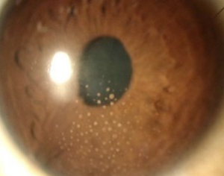
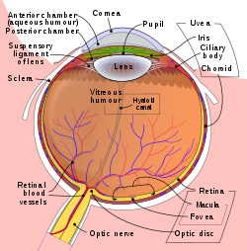
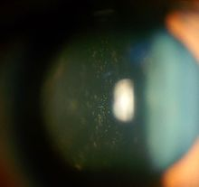
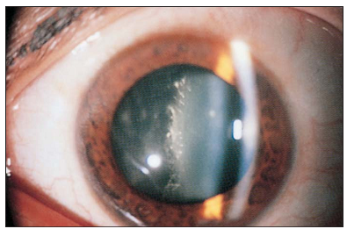
Endothelial dusting
‘dirty’ appearance. True, keratic precipitates (KP).
non-granulomatous
Aqueous cells: indicate disease activity and their number reflects disease severity.
Anterior vitreous cells : indicate iridocyclitis.

Slide 7
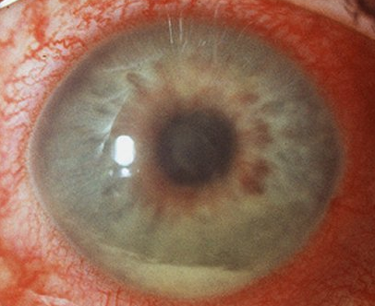
Aqueous Flare : breakdown of the blood–aqueous barrier
Aqueous Fibrinous Exudate
HLA-B27-associated AAU
Hypopyon :
Inflammatory Cells settled in the inferior part of the anterior chamber (AC) form a horizontal level.
In AAU associated with HLA-B27 the hypopyon has a high fibrin content which makes it dense, immobile and slow to absorb.
In patients with Behçet syndrome, minimal fibrin and shifts according to the patient’s head position and may disappear quickly.
Hypopyon associated with Blood may occur in Herpetic Infection and in eyes with associated Rubeosis Iridis.

Slide 8
Posterior Synechiae:
may develop quickly.
Low Intraocular Pressure (IOP):
may occur as a result of reduced secretion of aqueous by the ciliary epithe­lium.
Fundus Examination:
is usually normal.
……………………………………………………………
Duration. With appropriate therapy the inflamma­tion tends to completely resolve within 5–6 weeks.
The prognosis is usually very good.

Slide 9
Chronic anterior uveitis
(CAU) is less common than the acute type .
Persistent inflamma­tion that promptly relapses, in less than 3 months.
may be Granulomatous or Non-Granulomatous.
Bilateral involvement is more common than in AAU.

Slide 10
Presentation :
Symptoms:
insidious and many patients are asymptomatic until the development of complications such as cataract or band keratopathy.
Because of the lack of symptoms patients at risk of developing CAU should be routinely screened; especially juvenile idiopathic arthritis.
Signs:
External examination :
white eye.
Aqueous cells
vary in number according to disease activity .
Aqueous flare :
May be more marked than cells in eyes with prolonged activity .
its severity may act as an indicator of disease activity (contrary to previous teaching)

Slide 11
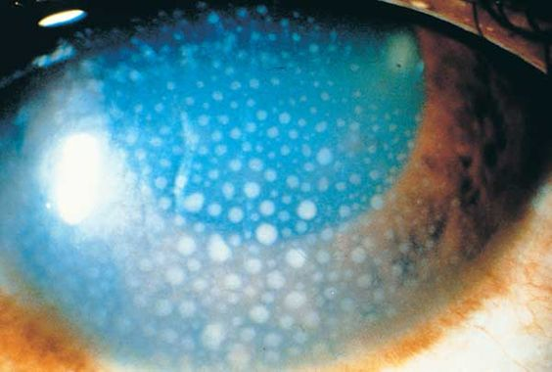
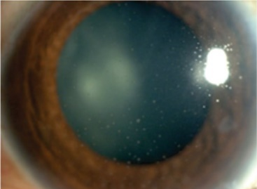
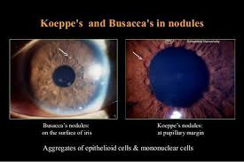
Presentation
KP :
Clusters of cellular deposits on the corneal endothelium composed of epithelioid cells, lym­phocytes and polymorphs .
• Large KP :
Granulomatous disease ,greasy (‘mutton-fat’) appearance.
more numerous inferiorly ,form in a triangular pattern with the apex pointing up (Arlt triangle ).
• Resolved (Mutton-Fat) Granulomatous KP:
Ground-glass appearance (Ghost KP).
• Long-standing Non-Granulomatous KP:
Pigmented and less dense centrally.
Dilated Iris Vessels
(Pseudo-Rubeosis) occasion­ally seen in long-standing cases and resolve with treatment.
Iris Nodules: typically occur in Granulomatous Disease.
Koeppe nodules are small and situated at the pupillary border.
Busacca nodules involve the iris stroma.

Slide 12
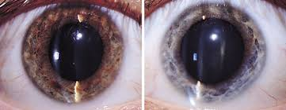
Presentation :
Iris Atrophy :
Sectoral occurs characteristically in Herpes Simplex Herpes Zoster.
Diffuse iris atrophy occurs in Fuchs uveitis syndrome.
The duration :prolonged and last for many months or even years.
Remissions and exacerbations of inflammatory activity are common .
The prognosis is guarded because of complications such as
1. Cataract
2. Glaucoma
3. Hypotony

Slide 13
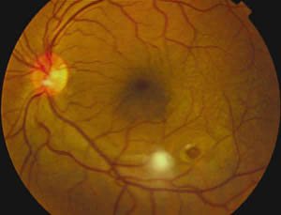
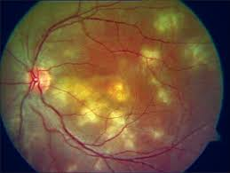
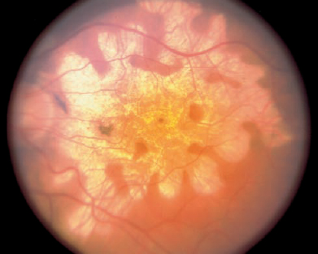
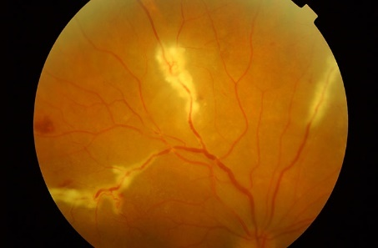
Posterior uveitis
Retinitis,
Choroiditis
Retinal Vasculitis.
Presentation floaters and or impaired central vision.
Retinitis:
may be focal (solitary), multifocal, geo­graphic or diffuse.
Active lesions: whitish retinal opacities with indistinct borders.
Choroiditis :
may be focal, multifocal, geographic or diffuse.
Usually no vitritis in the absence of concomitant retinal involvement.
Active choroiditis is characterized by a round, yellow nodule.
Retinal Vasculitis:
primary condition or as a secondary phenomenon adjacent to a focus of retinitis.
Both arteries (periarteritis) and veins (periphlebitis) may be affected .
Active vasculitis is characterized by yellowish or grey-white, patchy, perivascular cuffing .

Slide 14
SPECIAL INVESTIGATIONS FOR UVEITIS
Not Indicated
Single attack of mild unilateral AAU without suggestion of a possible underlying disease.
A specific uveitis entity such as sympathetic ophthalmitis and Fuchs cyclitis.
When a systemic diagnosis compatible with the uveitis is already apparent such as Behçet disease or sarcoidosis. .
Indicated
Granulomatous inflammation.
Recurrent uveitis.
Bilateral disease.
Systemic manifestations without a specific diagnosis.

Slide 15
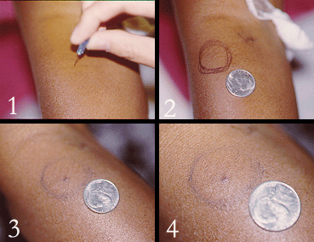
Skin tests
1. Tuberculin skin tests (Mantoux and Heaf) : intradermal injection of purified protein derivative of M. tuberculosis.
2. Pathergy test
(increased dermal sensitivity to needle trauma) is a criteria for the diagnosis of Behçet syndrome, but the results vary and it is only rarely positive in the absence of systemic activity. A positive response is the formation of a pustule follow­ing pricking of the skin with a needle .
3. Lepromin test :
involves intradermal injection of an extract of leprosy bacilli.

Slide 16
Toxoplasmosis tests
1. Dye test (Sabin-Feldman)
2. Immunofluorescent antibody .
3. Hemagglutination tests
coating of lysed organisms on to red blood cells .
4. Enzyme-linked immunosorbent assay (ELISA) binding of the patient’s antibodies to an excess of solid phase antigen.

Slide 17
Serology
should be performed in all patients with uveitis who require investigation.
Infectious diseases: Syphilis, TB, Leprosy
Non-infectious (Immunological diseases), Sarcoidosis, SLE, RA, Collagen vascular Diseases, Multiple Sclerosis (Auto-Immune Diseases)
Syphilis :
Non-Treponemal Tests :
rapid plasma reagin (RPR) or Venereal Disease Research Laboratory (VDRL)
best used to diagnose primary infection, monitor disease activity or response to therapy based on titre.
Non Sensitive
Non Specific.

Slide 18
2. Treponemal Antibody Tests:
Highly Sensitive
Specific .
Useful to prove past infection, as well as active secondary or tertiary forms of clinical infection.
Commonly used Tests:
Fluorescent Treponemal Antibody Absorption Test (FTA-ABS)
Microhaemagglutination Treponema Pallidum Test (MHA-TP)
3. Dark-Ground Microscopy:
of exudate from a mucocutaneous lesion is reliable if positive.

Slide 19
Enzyme assay
1. Serum angiotensin-converting enzyme (ACE) i:
a non-specific test which indicates the presence of a Granulomatous disease:
Sarcoidosis,
Tuberculosis
Leprosy.
may be normal during remissions.
2. Lysozyme assay :
has good sensitivity but less specificity than ACE in the diagnosis of sarcoidosis .
performing both tests seems to increase sensitivity and specificity.

Slide 20
Immunological diseases Tests
Rheumatoid Factor
Anti-Nuclear Factor
Cardiolipin Antibody

Slide 21
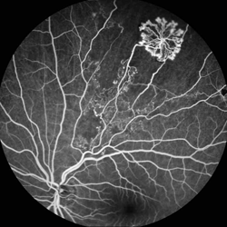
Imaging:
1. Fluorescein Angiography (FA) :is useful in the follow­ing circumstances.
Evaluation of (Retinal Vasculitis).
Diagnosis of macular disease, particularly Cystoid Macular Oedema (CMO) .
Diagnosis of Choroidal Neovascu­larization (CNV).
2. Indocyanine Green Angiography (ICGA) :
is better suited for evaluating Choroidal Disease
3. Optical coherence tomography (OCT) :
is useful in detecting complications such as Macular Oedema.

Slide 22
Radiology
Chest X-ray:
to exclude tuberculosis and sarcoidosis.
2. Sacroiliac Joint X-ray :
Spondyloarthropathy in the presence of symptoms of low back pain and uveitis.
3. CT and MRI:
Brain and Thorax may be appropriate in the investigation of sarcoidosis, multiple sclerosis and primary intraocular lymphoma.

Slide 23
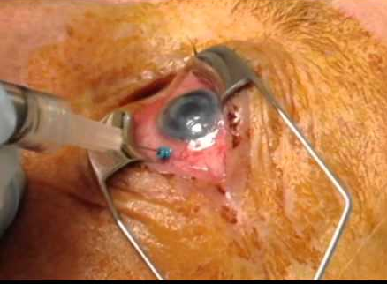
Biopsy
Histopathology still remains the gold standard for definitive diagnosis of many conditions.
Biopsies of the skin or other organs may establish the diagnosis of a systemic disorder associated with the ocular manifestations, such as sarcoidosis.
Biopsy from:
1. Conjunctival and lacrimal gland
2. Aqueous samples
3. Vitreous biopsy

Slide 24
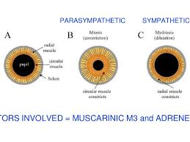
PRINCIPLES OF TREATMENT
General principles
Treatment of immune-mediated uveitis involves predominantly the use of anti-inflammatory and immunosuppressive agents.
It is important to keep in mind that these drugs have potential side-effects.
Mydriatics :
1. Short-acting :
a. Tropicamide (0.5% and 1%) has a duration of 6 hours.
b. Cyclopentolate (0.5% and 1%) has a duration of 24 hours.
c. Phenylephrine (2.5% and 10%) has a duration of 3 hours but no cycloplegia.
2. Long-acting
a. Homatropine 2% has a duration of up to 2 days.
b. Atropine 1% is the most powerful cycloplegic and mydriatic with a duration of up to 2 weeks.

Slide 25
Indications
1. To promote comfort :
by relieving spasm of the ciliary muscle and pupillary sphincter.
usually with atropine or homatropine.
2. To break down recently formed posterior synechiae :
with intensive topical mydriatics (atropine, phenylephrine) .
or subconjunctival injection of Mydricaine® (adrenaline, atropine and procaine) in eyes that do not respond to drops.
3. To prevent formation of posterior synechiae :
following control of acute inflammation by using a short-acting mydriatic

Slide 26
Topical steroids
Indications
1. Treatment of AAU is usually relatively straightforward.
• Initially hourly.
2. Treatment of CAU :
is more difficult because long-term therapy is often required with the risk of complica­tions
Complications
1. Elevation of IOP is common in (‘steroid responders’).
2. Cataract by both systemic and, less frequently, topical steroid administration.
3. Corneal complications uncommon, include secondary infection with bacteria and fungi, recrudescence of herpes simplex keratitis, and corneal melting.
4. Systemic side-effects are rare.

Slide 27
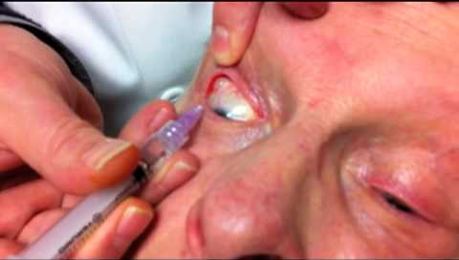
Periocular steroid injection
Advantages over topical administration
• Therapeutic concentrations behind the lens may be achieved.
• Water-soluble drugs can inter the eye trans-sclerally when given by peri-ocular injection.
• A prolonged effect can be achieved with ‘depot’ preparation such as triamcinolone acetonide (Kenalog) or methylprednisolone acetate (Depomedrone).

Slide 28
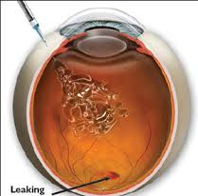
Intraocular steroids injection
• Triamcinolone acetonide (4 mg in 0.1 mL) posterior uveitis and CMO
• Irapid resolution of CMO lasting about 4 months.
Systemic steroids
Preparations
a. Oral prednisolone 5 or 25 mg tablets are the main preparations.
b. Intravenous infusion of methylprednisolone 1 g/day, repeated for 2 to 3 days is an option in severe disease.

Slide 29
Antimetabolites
Indications
1. Sight-threatening uveitis,.....
2. Steroid-sparing therapy .....
Azathioprine
Indications >>>chronic conditions such as Behçet syndrome and Vogt–Koyanagi–Harada syndrome.
Methotrexate
Indications >>
mainly as a steroid-sparing agent in patients with uveitis associated with sarcoidosis and juvenile idiopathic arthritis.

Slide 30
Dose and route
• Adult 10–25 mg weekly orally or intramuscularly.
• Children required a higher dose (up to 30 mg) since the clearance of the drug is increased.
• Folic acid at 2.5–5 mg/day is administered to reduce bone marrow toxicity.
Side-effects i>>>
bone marrow suppression, hepatotoxicity, acute pneumonitis (hypersensitivity reaction) are the most serious, but rarely occur with low-dose therapy.
Less severe adverse effects include nausea, vomiting, mouth ulcers and alopecia.
Monitoring >>>
involves a full blood count and liver func­tion tests

Slide 31
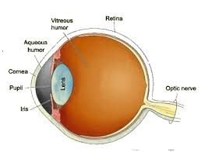
INTERMEDIATE UVEITIS
Overview
(IU) is an insidious, chronic, relapsing disease in which the vitreous is the major site of inflammatory signs.
The condition may be idiopathic or associated with a systemic disease .
Pars planitis (PP) is a subset of IU in which there is ‘snowball’ formation.
IU accounts for up to 15% of all uveitis cases and about 20% of paediatric uveitis.

Slide 32
Presentation :
insidious onset
blurred vision
vitreous floaters.
Anterior uveitis
• In PP there may be a few cells and small scattered KP.
• In the other forms of IU, anterior uveitis can be severe, especially in patients with sarcoidosis and Lyme disease.
Vitreous
• Vitreous cells .
• Vitreous condensation and haze .
• Vitreous snowballs

Slide 33
Posterior segment
• Peripheral periphlebitis particularly in patients with MS .
• Neovascularization >>>on the ‘snowbank’ or the optic nerve head.
• Subtle disc oedema >>>especially in young patients.

Slide 34
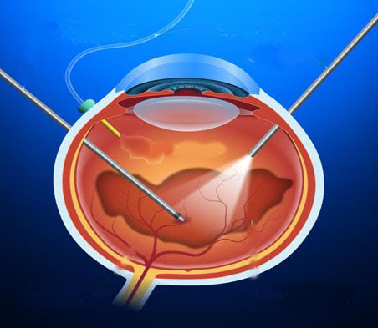
Treatment
Medical. :
topical steroids or posterior periocular steroid injections.
further options in unresponsive cases include systemic steroids and immunosuppressive agents.
Vitrectomy
beneficial for CMO as well as the inflammatory process itself.
Laser photocoagulation >>>useful in eyes with neovascularization of the vitreous base.
Systemic associations
1. Multiple sclerosis-associated should be suspected in females in the 3rd–4th decades .
2. Sarcoidosis-associated IU >>>The presence of associated granulomatous anterior uveitis should arouse suspicion.
3. Tuberculosis is an uncommon association.

Slide 35
UVEITIS IN SPONDYLOARTHROPATHIES
HLA-B27 and spondyloarthropathies
A strong association exists between HLA-B27 and spondyloarthropathies;
Ankylosing spondylitis
Definition. :(AS) is characterized by inflammation, calcification and finally ossification of ligaments and capsules of joints with resultant bony ankylosis of the axial skeleton.
It typically affects males, of whom 90% are HLA-B27 positive;
some patients also have inflammatory bowel disease (enter­opathic arthritis).

Slide 36
Presentation :
in the 3rd–4th decades with insidious onset of pain and stiffness in the lower back or buttocks.
Signs
Spondyloarthritis causes progressive limitation of spinal movements and eventually the spine may become fixed in flexion.
Radiology >>>sacroiliac joints reveals:
juxta-articular osteoporosis in the early stages,.
sclerosis and bony obliteration of the joint .
AAU :
occurs in about 25% of patients with AS
conversely, 25% of males with AAU will have AS. Either eye is frequently affected at different times but bilateral simultaneous involvement is rare.

Slide 37
Reiter syndrome
Definition. >>>
triad of
non-specific (non-gonococcal) urethritis,
conjuncti­vitis
arthritis.
About 85% of patients are positive for HLA-B27.
Pathogenesis.
RS develops after enteric infections caused by
Shigella, Salmonella and Campylo­bacteria.
Post-dysenteric RS affects males and females equally,
post-venereal RS is more common in men.

Slide 38
Presentation :
in the 3rd–4th decades with non-specific urethritis, conjunctivitis and arthritis classically a month after dysentery or sexual intercourse.
Signs
a. Peripheral arthritis is acute, asymmetrical and migratory. Two to four joints .
b. Spondyloarthritis :affects about 30% of patients with severe chronic RS and is related to the presence of HLA-B27.
c. Mucocutaneous lesions include painless mouth ulceration, circinate balanitis, kerato­derma blenorrhagica involving the palms and soles and nail dystrophy.
d. Genitourinary involvement causes cystitis, cervicitis, prostatitis, epididymitis and orchitis.
AAU occurs in up to 12% patients but is higher in carriers of HLA-B27.
Conjunctivitis :
follows the urethritis by about 2 weeks and precedes the arthritis.
The inflammation is usually mild, bilateral and mucopurulent.

Slide 39
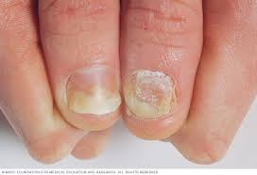
Psoriatic arthritis
affects both sexes equally
associated with an increased prevalence of HLA-B27.
Presentation: 3rd–4th decades.
Signs
a. Skin
• Plaque psoriasis (most common).
b. Nail dystrophy is characterized by pitting, transverse depression.
c. Arthritis is typically asymmetrical, although some patients may develop ankylosing spondylitis.
d. AAU occurs in approximately 7% of arthritis patients.

Slide 40
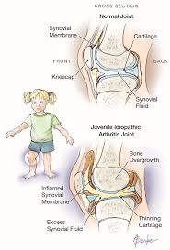
UVEITIS IN JUVENILE ARTHRITIS
Juvenile idiopathic arthritis
(JIA) is an inflammatory arthritis of at least 6 weeks’ duration
occurring before the age of 16 years when all other causes, such as infection, metabolic disorders or neoplasms have been excluded.
Females :male ratio=3 : 2.
JIA is by far the most common disease associated with child­hood anterior uveitis.
Arthritis
Presentation >>>depend on onset and the extent of joint involvement during the first 6 months.

Slide 41
Anterior uveitis
Presentation :
asymptomatic; the uveitis is frequently detected on routine slit-lamp examination.
vitreous floaters.
arthritis antedates the diagnosis of uveitis.
Signs
• >>chronic and non-granulomatous.
• Bilateral in 70%.
• When bilateral, its>>symmetrical.
• white eye
• endothelial ‘dusting’ without hypopion.
• Posterior synechiae are common .

Slide 42
Treatment:
topical steroids is usually effective;
periocular injections
Low-dose methotrexate is useful for steroid resistance.

Slide 43
UVEITIS IN BOWEL DISEASE
Ulcerative colitis
Crohn disease

Slide 44
SARCOIDOSIS
is a T-lymphocyte-mediated non-caseating granulomatous inflammatory disorder of unknown cause.
It is most common in colder climates,
more frequently affects patients of African descent than Cauca­sians.
The tissues most commonly involved are the mediastinal and superficial lymph nodes, lungs, liver, spleen, skin, parotid glands, phalangeal bones and the eye.

Slide 45
Presentation
Acute-onset sarcoidosis presents in young patients ......
Ocular features
Uveitis is the most common and may be in the form of anterior, posterior or intermediate. Other manifestations include KCS, conjunctival nodules, and rarely, orbital and scleral lesions.
1. AAU typically affects patients with acute-onset sarcoid.
2. CAU, typically granulomatous, tends to affect older patients with chronic pul­monary disease.
• Iris nodules may be very larg.

Slide 46
3. Intermediate uveitis :with snowballs or string-like opacities is uncommon and may antedate systemic disease.
4. Periphlebitis
5. Choroidal infiltrates .
6. Retinal granulomas are small discrete yellow-white lesions .
7. Peripheral retinal neovascularization may develop secondary to retinal capillary dropout.
8. Optic nerve involvement may take the following forms:
• Focal granulomas,.
• Papilloedema due to CNS involvement .
• Persistent disc oedema .

Slide 47
9. Treatment
of anterior uveitis is with topical and/or periocular steroids.
Posterior uveitis often requires systemic steroids and occasionally immunosuppres­sive agents such as methotrexate, azathioprine and cyclosporine.

Slide 48
BEHÇET SYNDROME
Behçet syndrome (BS) is an idiopathic, multisystem disease :
Orogenital ulceration
Vasculitis which may involve small, medium and large veins and arteries.
Eastern Mediterranean region and Japan
(HLA) B51.
The peak age = 3rd decade
Males > females.

Slide 49
Ocular features
Ocular complications occur in up to 95% of men and 70% of women.
usually bilateral
3rd– 4th decades.
AAU,
bilateral
transient mobile hypopyon in a relatively white eye (‘cold hypopyon’) It usually responds well to topical steroids.
2. Retinitis
3. Retinal vasculitis may involve both veins and arteries and result in occlusion Vascular leakage may give rise to diffuse retinal oedema, CMO and disc oedema.
4. Vitritis, which may be severe and persistent, is uni­versal in eyes with active disease.
5. End-stage disease is characterized by optic atrophy, vascular occlusion.

Slide 50
Treatment of posterior uveitis
1. Systemic steroids may shorten the duration of an inflammatory episode .
2. Azathioprine does not act rapidly enough in acute disease but is suitable for long-term therapy.
3. Ciclosporin is effective and rapidly acting but is associated with nephrotoxicity.

Slide 51
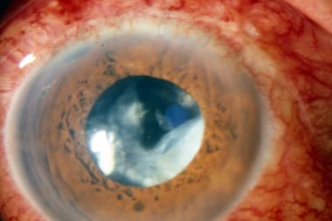
Lens-induced uveitis
is triggered by an immune response to lens proteins following rupture of the lens capsule, which may be due to trauma or incomplete cataract extraction
Phacoanaphylactic endophthalmitis

Slide 52
Herpes simplex anterior uveitis
. Varicella zoster anterior uveitis
Congenital rubella
Rubella (German measles) is usually a benign febrile exanthema. Congenital rubella results from transplacental transmission of virus to the fetus from an infected mother,.
1. Anterior uveitis may result in iris atrophy.
2. Retinopathy is a common manifestation, but the exact incidence is unknown because cataracts frequently impair visualization of the fundus.
• ‘Salt and pepper’ pigmentary disturbance involv­ing the periphery and posterior pole .

Slide 53
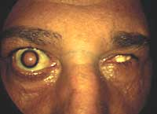
Sympathetic ophthalmitis
is a bilateral granulomatous panuveitis occurring after penetrating trauma, often associated with uveal prolapse, or, less frequently, following intraocular surgery.
The traumatized eye is referred to as the exciting eye and the fellow eye, which also develops uveitis, is the sympathizing eye.

Slide 54
. Presentation in 65% of cases is between 2 weeks and 3 months after initial injury and 90% of all cases occur within the first year.
.
Signs in chronological order:
The exciting eye: evidence of the initial trauma and is frequently very red and irritable.
The sympathizing eye: irritation, blurred vision, photophobia and loss of accommodation.
Both eyes develop anterior uveitis.
Multifocal choroidal infiltrates.
Exudative retinal detachment

Slide 55
. Ultrasound may show choroidal thickening and retinal detachment.
. Treatment
a. Enucleation within first 10 days following trauma should be considered only in eyes with a hopeless visual prognosis because the exciting eye may eventually have better vision than the sympathiz­ing eye. Evisceration does not seem to protect against SO.
b. Topical treatment of the anterior uveitis with ster­oids and cycloplegics is given but the inflamma­tion tends to be resistant to this form of therapy (diagnostic clue).
c. Systemic steroids are usually effective although ciclosporin or azathioprine may be required in resistant cases..

Slide 56
Thank You

